Slide 1

The Business Problem
Given an IT department’s operational data for multiple software machines, is it possible to predict run time anomalies to investigate potential failures and prevent downtimes before they happen.

Slide 2
Context
Software operational data for 100 machines
Anomaly detection in a single machine
Cost reduction
Customer retention

Slide 3
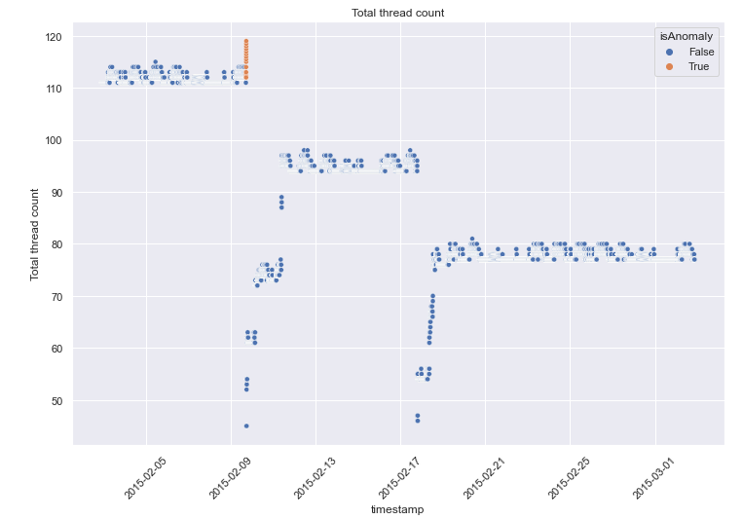
Data Analysis
Total thread count
Notes:
Hypothesis: Create a Hypothesis with an emphasis on SMART principles. (S – Specific, M – Measurable, A – Achievable, R – Realistic, T – Timebound). If you cannot do this, you do not have a good grasp on the business problem.
Context: With context, we have clearly identified the problem at hand and have elucidated on how our initiative may solve this problem, alongside the commercial implications this will have on the business.
Criteria for Success: Clearly defining the criteria for success ensures that the scope of your work is clearly defined and understood. Otherwise, if this isn’t defined – your work will never end which will result in mismatched expectations.
Scope of Solution Space: Scoping out the solution space ensures that the business initiative is SPECIFIC for a certain segment or area. This prevents solutions that have been developed being scaled and applied for all other business units that the solution may not be responsible or scalable for.
Constraints within Solution Space: Looking forward, what are the foreseeable problems we are likely to encounter? Could this be stakeholder resistance? Could this be we don’t have access to the right data?
Stakeholders to provide key insight: Who are the people I need to speak to, to get the answers I need for my data analysis?
What key data sources are required?
Based off my discussions with the key stakeholders – can we clearly list out all the data sources we need so we can make a highly targeted request as opposed to a scatter-gun approach where we ask for a bit of everything?

Slide 4
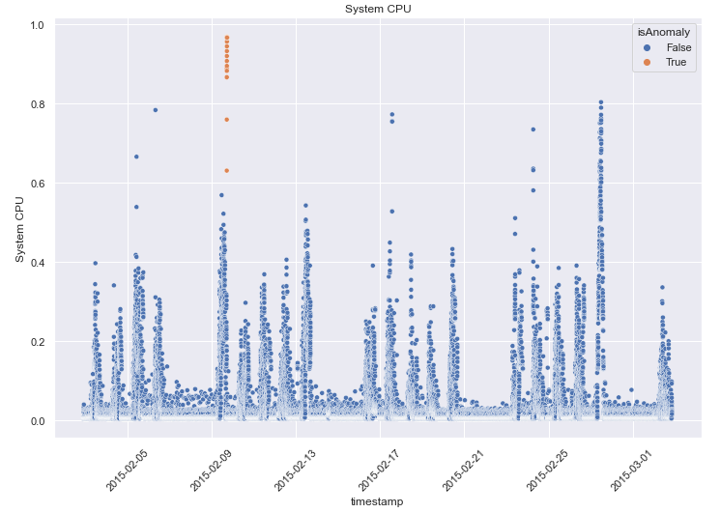
Data Analysis
System CPU

Slide 5
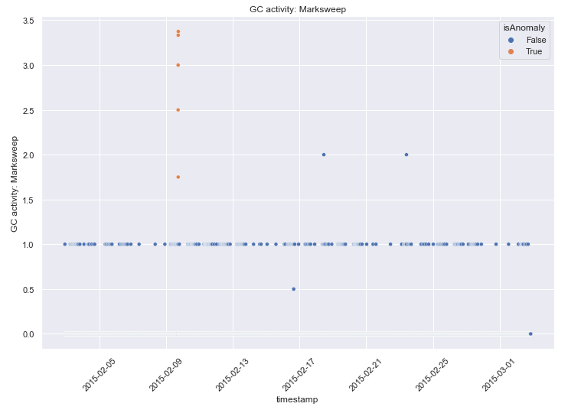
Data Analysis
GC Activity: Marksweep
Notes:
Hypothesis: Create a Hypothesis with an emphasis on SMART principles. (S – Specific, M – Measurable, A – Achievable, R – Realistic, T – Timebound). If you cannot do this, you do not have a good grasp on the business problem.
Context: With context, we have clearly identified the problem at hand and have elucidated on how our initiative may solve this problem, alongside the commercial implications this will have on the business.
Criteria for Success: Clearly defining the criteria for success ensures that the scope of your work is clearly defined and understood. Otherwise, if this isn’t defined – your work will never end which will result in mismatched expectations.
Scope of Solution Space: Scoping out the solution space ensures that the business initiative is SPECIFIC for a certain segment or area. This prevents solutions that have been developed being scaled and applied for all other business units that the solution may not be responsible or scalable for.
Constraints within Solution Space: Looking forward, what are the foreseeable problems we are likely to encounter? Could this be stakeholder resistance? Could this be we don’t have access to the right data?
Stakeholders to provide key insight: Who are the people I need to speak to, to get the answers I need for my data analysis?
What key data sources are required?
Based off my discussions with the key stakeholders – can we clearly list out all the data sources we need so we can make a highly targeted request as opposed to a scatter-gun approach where we ask for a bit of everything?

Slide 6
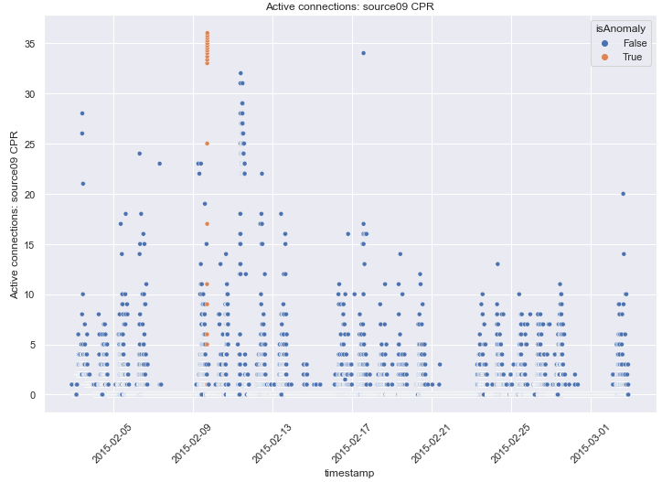
Data Analysis
Active connections: source09 CPR
Notes:
Hypothesis: Create a Hypothesis with an emphasis on SMART principles. (S – Specific, M – Measurable, A – Achievable, R – Realistic, T – Timebound). If you cannot do this, you do not have a good grasp on the business problem.
Context: With context, we have clearly identified the problem at hand and have elucidated on how our initiative may solve this problem, alongside the commercial implications this will have on the business.
Criteria for Success: Clearly defining the criteria for success ensures that the scope of your work is clearly defined and understood. Otherwise, if this isn’t defined – your work will never end which will result in mismatched expectations.
Scope of Solution Space: Scoping out the solution space ensures that the business initiative is SPECIFIC for a certain segment or area. This prevents solutions that have been developed being scaled and applied for all other business units that the solution may not be responsible or scalable for.
Constraints within Solution Space: Looking forward, what are the foreseeable problems we are likely to encounter? Could this be stakeholder resistance? Could this be we don’t have access to the right data?
Stakeholders to provide key insight: Who are the people I need to speak to, to get the answers I need for my data analysis?
What key data sources are required?
Based off my discussions with the key stakeholders – can we clearly list out all the data sources we need so we can make a highly targeted request as opposed to a scatter-gun approach where we ask for a bit of everything?

Slide 7
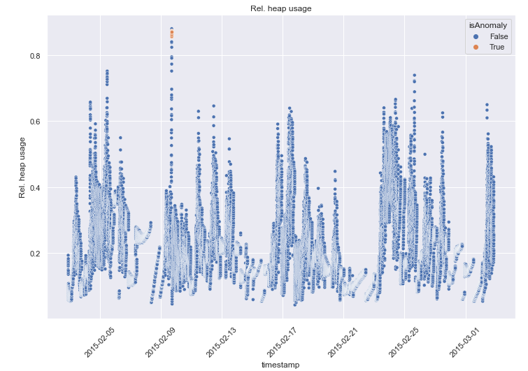
Data Analysis
Rel. heap usage
Notes:
Hypothesis: Create a Hypothesis with an emphasis on SMART principles. (S – Specific, M – Measurable, A – Achievable, R – Realistic, T – Timebound). If you cannot do this, you do not have a good grasp on the business problem.
Context: With context, we have clearly identified the problem at hand and have elucidated on how our initiative may solve this problem, alongside the commercial implications this will have on the business.
Criteria for Success: Clearly defining the criteria for success ensures that the scope of your work is clearly defined and understood. Otherwise, if this isn’t defined – your work will never end which will result in mismatched expectations.
Scope of Solution Space: Scoping out the solution space ensures that the business initiative is SPECIFIC for a certain segment or area. This prevents solutions that have been developed being scaled and applied for all other business units that the solution may not be responsible or scalable for.
Constraints within Solution Space: Looking forward, what are the foreseeable problems we are likely to encounter? Could this be stakeholder resistance? Could this be we don’t have access to the right data?
Stakeholders to provide key insight: Who are the people I need to speak to, to get the answers I need for my data analysis?
What key data sources are required?
Based off my discussions with the key stakeholders – can we clearly list out all the data sources we need so we can make a highly targeted request as opposed to a scatter-gun approach where we ask for a bit of everything?

Slide 8
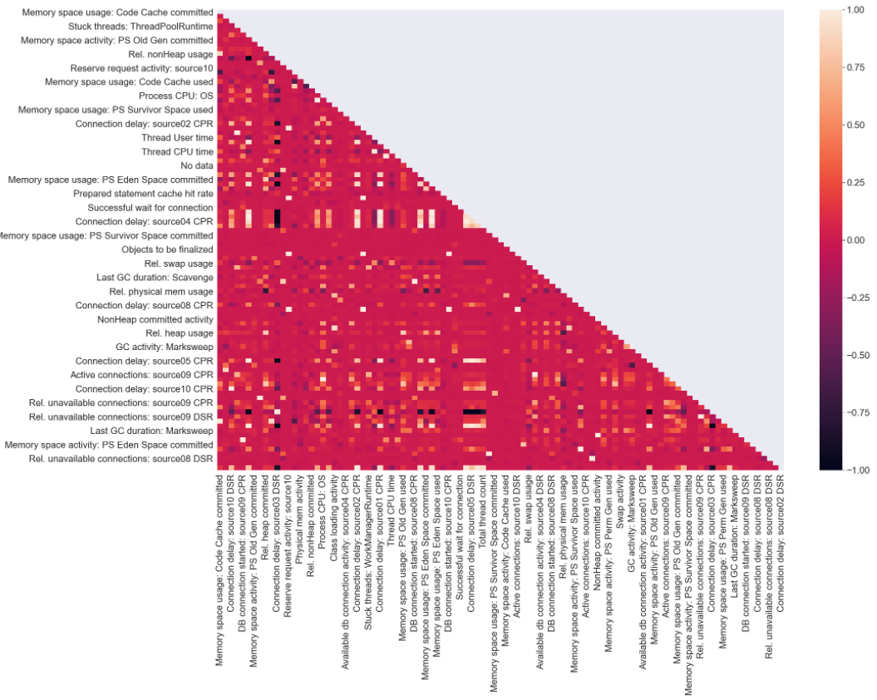
Data Analysis
Multiple features with a moderate to very high degree of correlation
Notes:
Hypothesis: Create a Hypothesis with an emphasis on SMART principles. (S – Specific, M – Measurable, A – Achievable, R – Realistic, T – Timebound). If you cannot do this, you do not have a good grasp on the business problem.
Context: With context, we have clearly identified the problem at hand and have elucidated on how our initiative may solve this problem, alongside the commercial implications this will have on the business.
Criteria for Success: Clearly defining the criteria for success ensures that the scope of your work is clearly defined and understood. Otherwise, if this isn’t defined – your work will never end which will result in mismatched expectations.
Scope of Solution Space: Scoping out the solution space ensures that the business initiative is SPECIFIC for a certain segment or area. This prevents solutions that have been developed being scaled and applied for all other business units that the solution may not be responsible or scalable for.
Constraints within Solution Space: Looking forward, what are the foreseeable problems we are likely to encounter? Could this be stakeholder resistance? Could this be we don’t have access to the right data?
Stakeholders to provide key insight: Who are the people I need to speak to, to get the answers I need for my data analysis?
What key data sources are required?
Based off my discussions with the key stakeholders – can we clearly list out all the data sources we need so we can make a highly targeted request as opposed to a scatter-gun approach where we ask for a bit of everything?

Slide 9
Modeling
Algorithms compared – Random Forest, Logistic Regression, XG Boost
Metric for scoring – Area under ROC curve
Algorithm chosen – XG Boost Classifier
Notes:
Hypothesis: Create a Hypothesis with an emphasis on SMART principles. (S – Specific, M – Measurable, A – Achievable, R – Realistic, T – Timebound). If you cannot do this, you do not have a good grasp on the business problem.
Context: With context, we have clearly identified the problem at hand and have elucidated on how our initiative may solve this problem, alongside the commercial implications this will have on the business.
Criteria for Success: Clearly defining the criteria for success ensures that the scope of your work is clearly defined and understood. Otherwise, if this isn’t defined – your work will never end which will result in mismatched expectations.
Scope of Solution Space: Scoping out the solution space ensures that the business initiative is SPECIFIC for a certain segment or area. This prevents solutions that have been developed being scaled and applied for all other business units that the solution may not be responsible or scalable for.
Constraints within Solution Space: Looking forward, what are the foreseeable problems we are likely to encounter? Could this be stakeholder resistance? Could this be we don’t have access to the right data?
Stakeholders to provide key insight: Who are the people I need to speak to, to get the answers I need for my data analysis?
What key data sources are required?
Based off my discussions with the key stakeholders – can we clearly list out all the data sources we need so we can make a highly targeted request as opposed to a scatter-gun approach where we ask for a bit of everything?

Slide 10
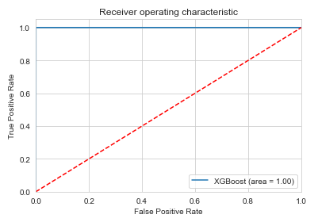
Modeling
Final score (area under roc curve): 1.0
Notes:
Hypothesis: Create a Hypothesis with an emphasis on SMART principles. (S – Specific, M – Measurable, A – Achievable, R – Realistic, T – Timebound). If you cannot do this, you do not have a good grasp on the business problem.
Context: With context, we have clearly identified the problem at hand and have elucidated on how our initiative may solve this problem, alongside the commercial implications this will have on the business.
Criteria for Success: Clearly defining the criteria for success ensures that the scope of your work is clearly defined and understood. Otherwise, if this isn’t defined – your work will never end which will result in mismatched expectations.
Scope of Solution Space: Scoping out the solution space ensures that the business initiative is SPECIFIC for a certain segment or area. This prevents solutions that have been developed being scaled and applied for all other business units that the solution may not be responsible or scalable for.
Constraints within Solution Space: Looking forward, what are the foreseeable problems we are likely to encounter? Could this be stakeholder resistance? Could this be we don’t have access to the right data?
Stakeholders to provide key insight: Who are the people I need to speak to, to get the answers I need for my data analysis?
What key data sources are required?
Based off my discussions with the key stakeholders – can we clearly list out all the data sources we need so we can make a highly targeted request as opposed to a scatter-gun approach where we ask for a bit of everything?

Slide 11
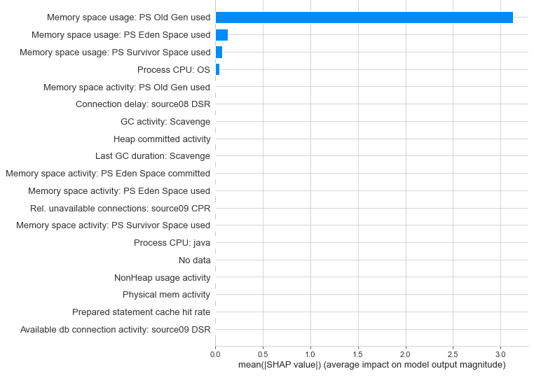
Most Important Features for Anomaly Detection
Notes:
Hypothesis: Create a Hypothesis with an emphasis on SMART principles. (S – Specific, M – Measurable, A – Achievable, R – Realistic, T – Timebound). If you cannot do this, you do not have a good grasp on the business problem.
Context: With context, we have clearly identified the problem at hand and have elucidated on how our initiative may solve this problem, alongside the commercial implications this will have on the business.
Criteria for Success: Clearly defining the criteria for success ensures that the scope of your work is clearly defined and understood. Otherwise, if this isn’t defined – your work will never end which will result in mismatched expectations.
Scope of Solution Space: Scoping out the solution space ensures that the business initiative is SPECIFIC for a certain segment or area. This prevents solutions that have been developed being scaled and applied for all other business units that the solution may not be responsible or scalable for.
Constraints within Solution Space: Looking forward, what are the foreseeable problems we are likely to encounter? Could this be stakeholder resistance? Could this be we don’t have access to the right data?
Stakeholders to provide key insight: Who are the people I need to speak to, to get the answers I need for my data analysis?
What key data sources are required?
Based off my discussions with the key stakeholders – can we clearly list out all the data sources we need so we can make a highly targeted request as opposed to a scatter-gun approach where we ask for a bit of everything?

Slide 12
Recommendation
Implement thresholds to alert stakeholders:
Memory space usage: PS Old Gen used – 0.165
Memory space usage: PS Eden Space used – 0.101
Memory space usage: PS Survivor Space used – 0.43
Process CPU: OS – 0.028

Slide 13
Future scope
Record more data for better cutoff limits
Analyze all software machines for additional cost savings
Time series analysis after enough data has been collected
Notes:
Hypothesis: Create a Hypothesis with an emphasis on SMART principles. (S – Specific, M – Measurable, A – Achievable, R – Realistic, T – Timebound). If you cannot do this, you do not have a good grasp on the business problem.
Context: With context, we have clearly identified the problem at hand and have elucidated on how our initiative may solve this problem, alongside the commercial implications this will have on the business.
Criteria for Success: Clearly defining the criteria for success ensures that the scope of your work is clearly defined and understood. Otherwise, if this isn’t defined – your work will never end which will result in mismatched expectations.
Scope of Solution Space: Scoping out the solution space ensures that the business initiative is SPECIFIC for a certain segment or area. This prevents solutions that have been developed being scaled and applied for all other business units that the solution may not be responsible or scalable for.
Constraints within Solution Space: Looking forward, what are the foreseeable problems we are likely to encounter? Could this be stakeholder resistance? Could this be we don’t have access to the right data?
Stakeholders to provide key insight: Who are the people I need to speak to, to get the answers I need for my data analysis?
What key data sources are required?
Based off my discussions with the key stakeholders – can we clearly list out all the data sources we need so we can make a highly targeted request as opposed to a scatter-gun approach where we ask for a bit of everything?

